Slide 1
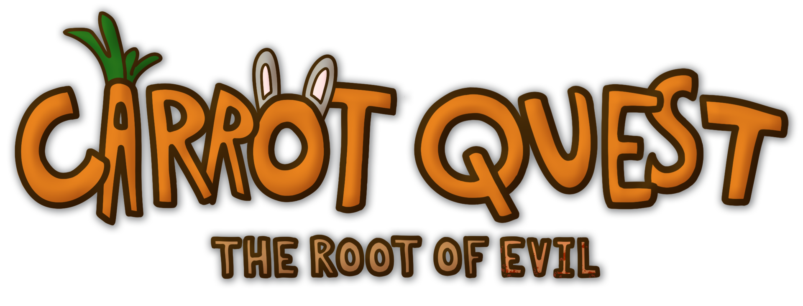

By Dark Root Studios

Slide 2

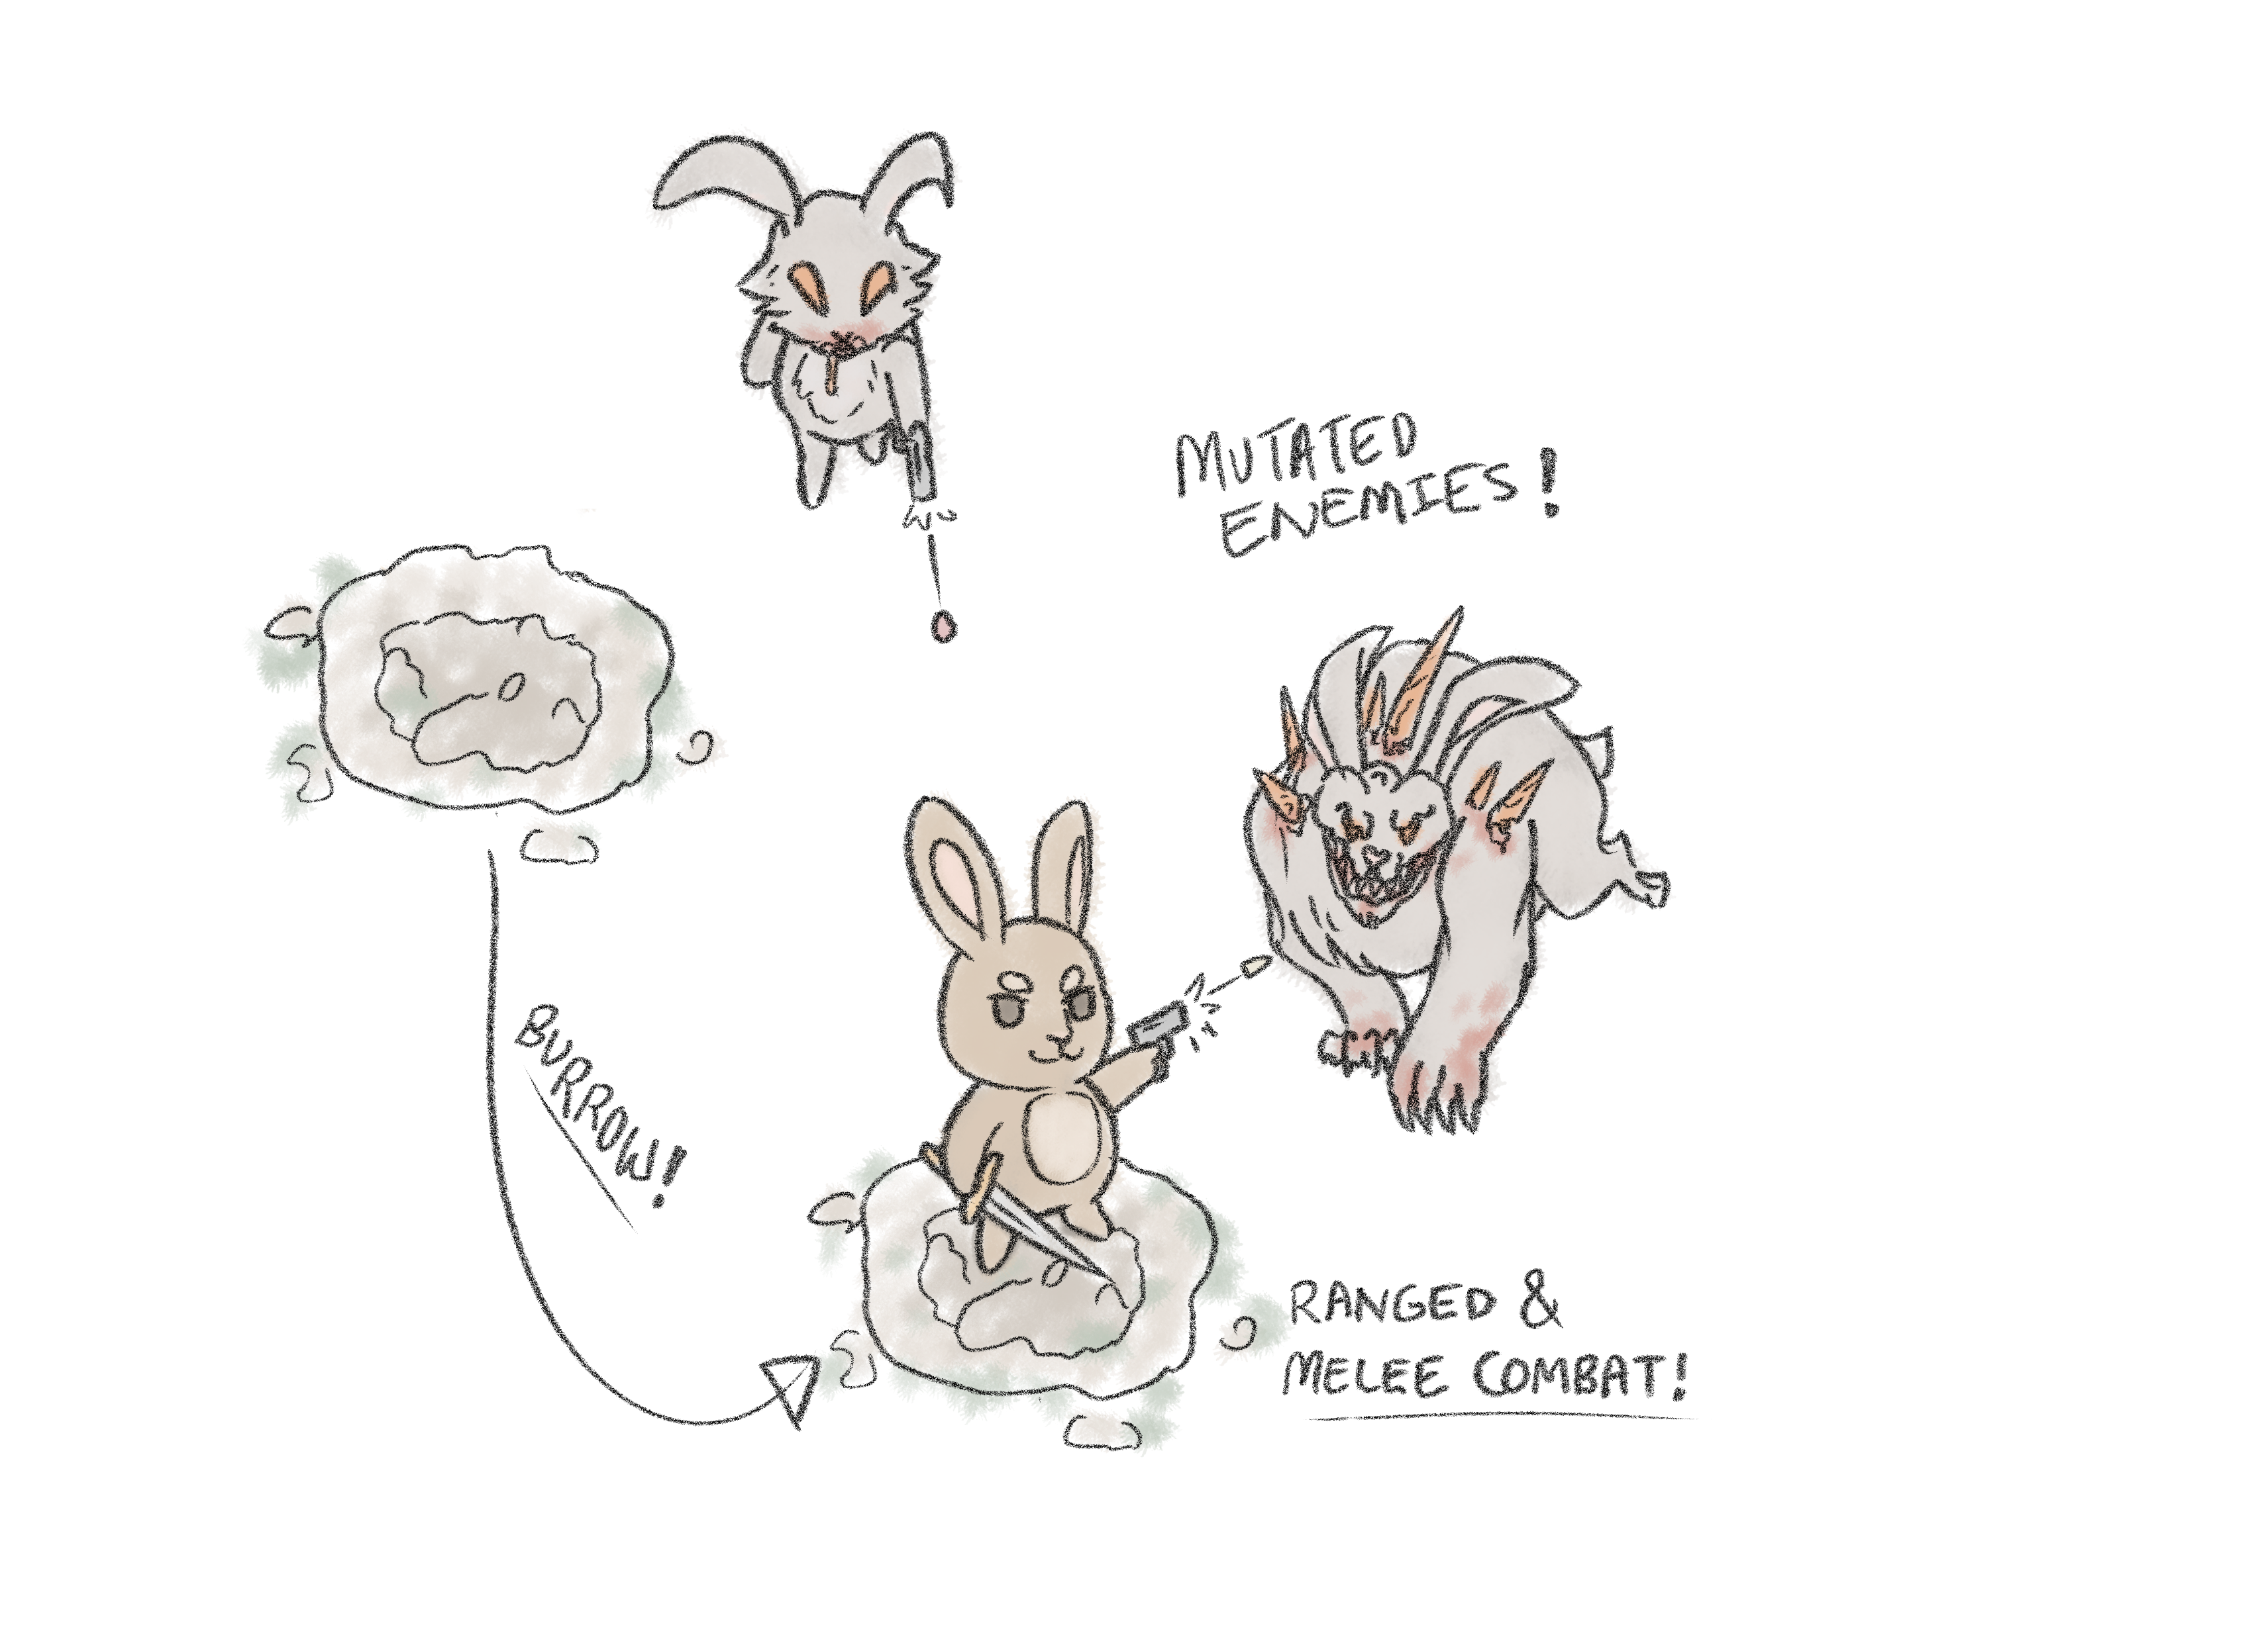
What is Carrot Quest ?
Imagine Enter the Gungeon meets The Legend of Zelda and Hollow Knight
Platform: PC ● Target Audience: Teens and up ● ESRB Rating: T ● Number of Players: 1
A bun with a GUN !
Mow through enemies in unique top-down combat, using the dodge and burrow mechanic to quickly traverse the battlefield!
Fight off the hideously mutated beasts created by the Carrot Curse and save the village of Bunnyville!

Slide 3

What evil lies beneath Bunnyville?
Piece together the secrets of the past from the remnants of the previous bunny civilization, the Carrot Kingdom…
Find and put an end to the source of the Carrot Curse once and for all!
Can you be the hero Bunnyville needs?

Slide 4
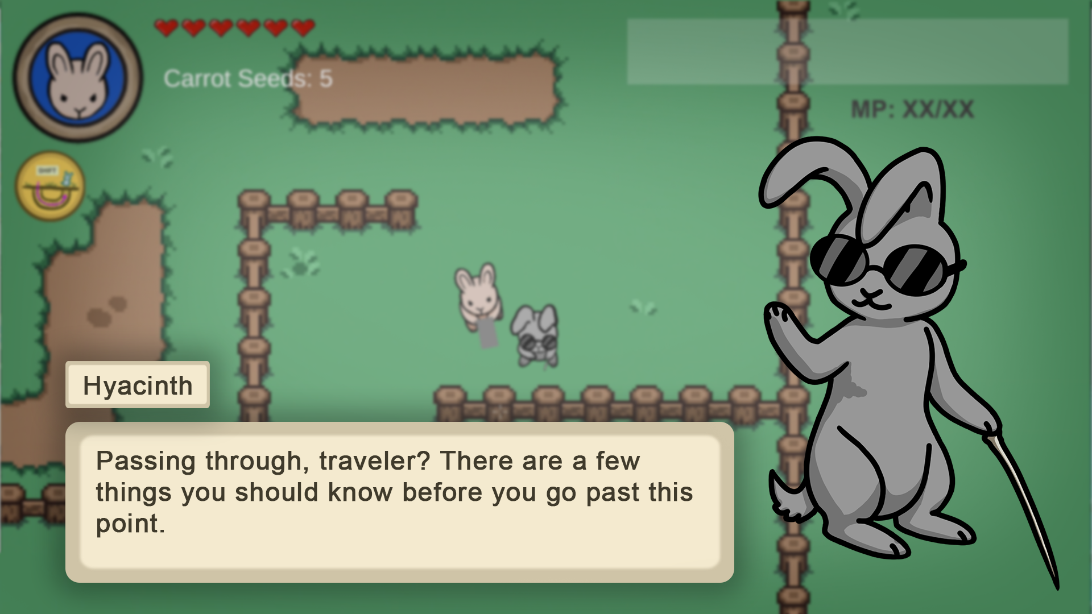
Explore the world of Carrot Quest
Enter a nature filled world with darkness and corruption lurking behind the corners
Navigate a variety of biomes as you follow the clues of the curse
Talk to Bunnyville villagers to learn about the world and build relationships

Slide 5
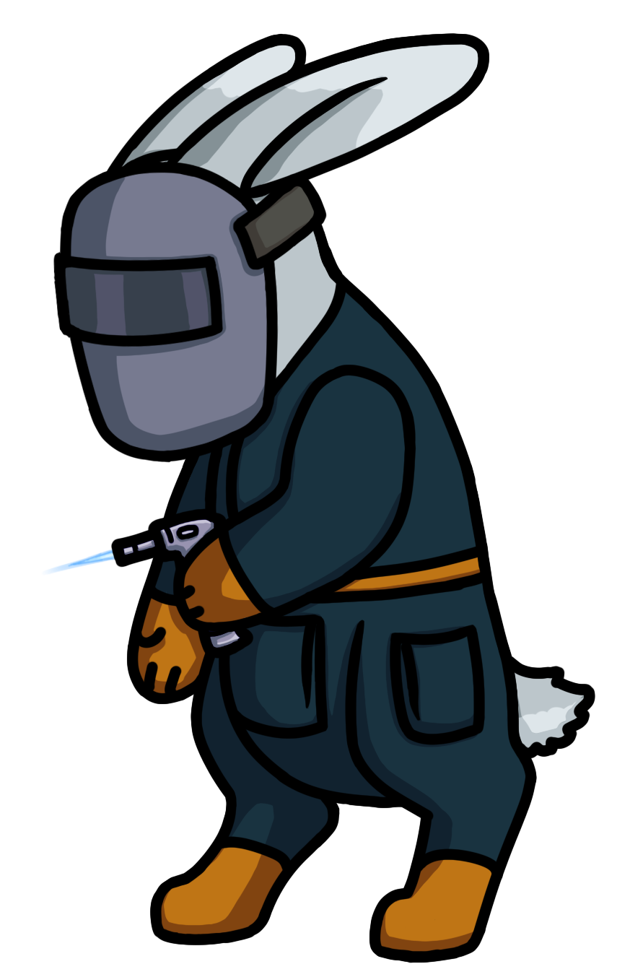

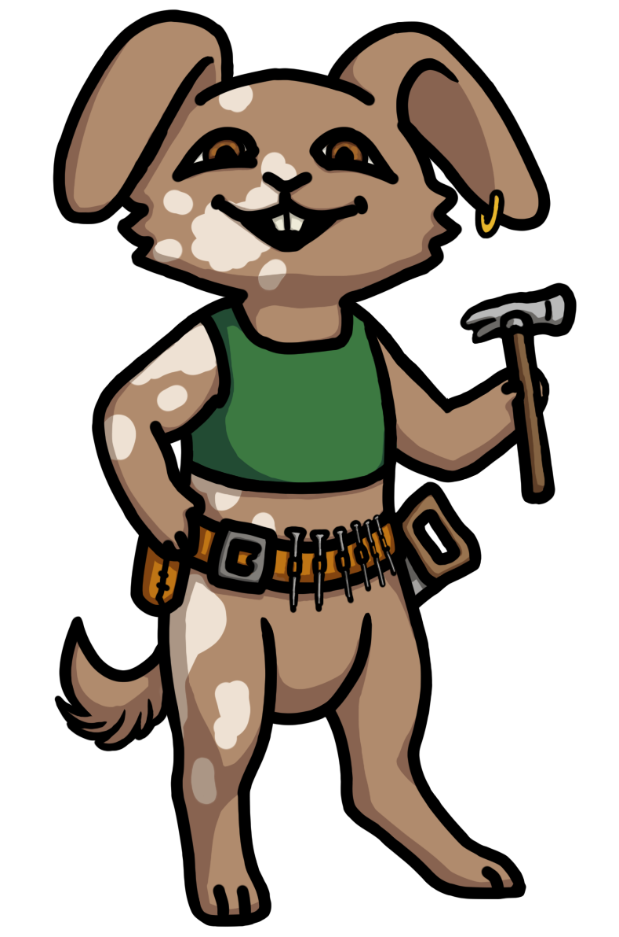

Who are you trying to save?
The peaceful village of Bunnyville needs your help!
Meet a large cast of villagers, each with interests and secrets of their own
Build relationships with the villagers as you talk to them and complete their quests
Hyacinth
Oakly
Dancer
Dewdrop
AND MORE !

Slide 6
Beware !
The cursed bunnies of this world will stop at nothing to eat you and your carrots!
Defeat a variety of terrifying foes mutated in unique ways by the Curse
Challenging boss battles will test your skills! Do you have what it takes to save Bunnyville?

Slide 7
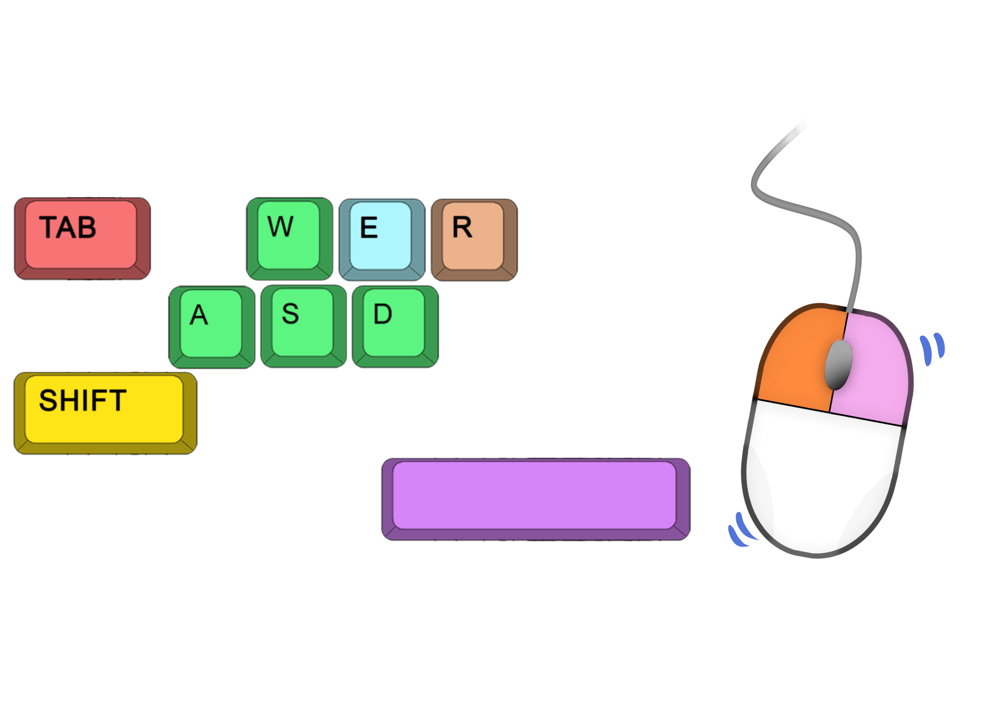

How do I play?
TAB to switch weapons
E to Interact
Move Mouse to Aim
R to Reload
LMB to Shoot
WASD to Move
RMB to Melee Attack
Hold SHIFT to Burrow
SPACE to Dodge

Slide 8


Where can I play?
COMING SOON TO STEAM AND EPIC !
Carrot Quest will be available as a one-time purchase of $4.99

Slide 9
Conclusion
AND
Top-down gun combat similar to Enter the Gungeon
+
Adventure and exploration of the early Zelda games
+
Melee combat & the themes and art of Hollow Knight
New Burrow Mechanic
+
Fluid combination of ranged and melee in a top down fighting game
+
A huge variety of skills and weapons to combo for dynamic combat !
COMING SOON IN 2024…

